Slide 1
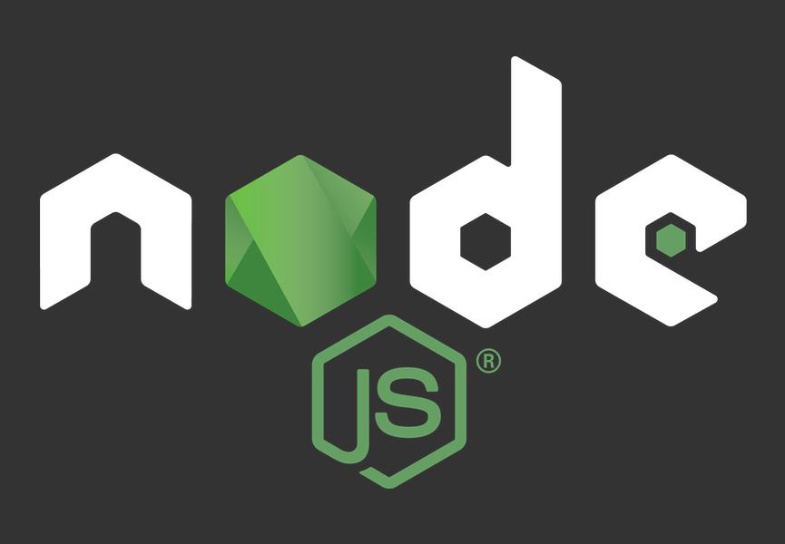

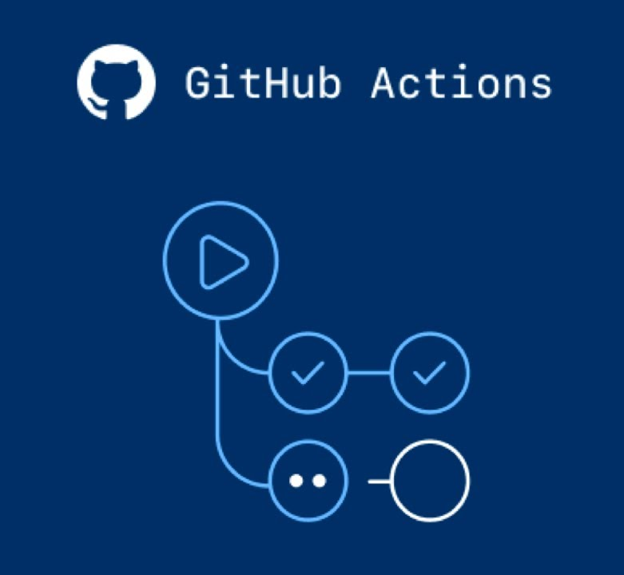
Adding Tests & Integrating
a CI/CD Pipeline
hands-on workshop

Slide 2
Before we start….some etiquette guidelines
Put your Mics on mute!
Click ‘Raise hand’ if you must interject
Unmute when asked to talk
Q & A session in the end
But feel free to add your questions / comments / issues in the chat during the workshop

Slide 3
What you will need to follow along:
Node.js installed
MongoDB installed and running
VS Code with Git Bash integrated
GitHub Account
Heroku Account

Slide 4
Let’s get familiar with some terms:
Automated testing
Automated testing is a software testing technique to test and compare the actual outcome with the expected outcome. This can be achieved by writing test scripts or using any automation testing tool. Test automation is used to automate repetitive tasks and other testing tasks which are difficult to perform manually. Read more
Continuous Integration
Continuous Integration (CI) is a development practice where developers integrate code into a shared repository frequently, preferably several times a day. Each integration can then be verified by an automated build and automated tests. Read more
Continuous Deployment
Continuous Deployment (CD) is a strategy for software releases wherein any code commit that passes the automated testing phase is automatically released into the production environment, making changes that are visible to the software's users. Read more

Slide 5
Defining the app specs

Slide 6
What are we building and testing today?
a server application with a CRUD API
using Node, Express, and Mongoose
5 API endpoints (Express routes) that create, read, list, update and delete articles from the database
Write unit tests for these API endpoints and run tests locally
Push code to a repository on GitHub
Add GitHub actions to the repository to run the tests on every push (CI)
Update GitHub action to auto deploy to Heroku only if all tests pass (CD)

Slide 7
App Features
An article has
Title - String and required
Content - String and optional
Make a POST request with data to save a new article in the Articles collection
This request should return 200 with a success message if article successfully saved
This request should return 400 with an error message if article not saved due to an error
Make a GET request to retrieve all the articles in the collection
Make a GET request containing an article ID in the route param to return the specific article from the collection, throw 400 if matching article not found
Make a PUT request with data and an ID in the route param to update the specified article in the collection
Make a DELETE request with an ID in the route param to remove the specified article from the collection

Slide 8
Setting up the codebase

Slide 9
Codebase Setup
Create an empty repository on GitHub
Clone to local file system and open in VS code
Run npm init to create a package.json file
Install necessary dependencies:
npm i --save express body-parser mongoose
Install development dependencies:
npm i --save-dev nodemon jest supertest babel-jest @babel/preset-env @babel/core
For Windows also do npm install -g win-node-env

Slide 10
Codebase Setup [...contd]
"scripts": {
"test": "NODE_ENV=test jest",
"start": "NODE_ENV=prod node app.js"
},
Add a script to run tests in package.json
Add Jest configuration in package.json
Configure Babel for Jest in a file called .babelrc.js:
Add a file named .gitignore with the following line:
"jest": {
"verbose": true,
"testEnvironment": "node"
},
module.exports = {
presets: [['@babel/preset-env', {targets: {node: 'current'}}]],
};
node_modules/

Slide 11
Code files
Create the following files to add the app code:
app.js
article.model.js
To add test code, create a __tests__ folder and in it add a file named app.test.js. In this file, let’s add the following structure:
// Add import statements
describe("When the article CRUD server is running", ()=>{
// Add individual test cases
afterAll( /* add things that should happen after all tests are run */ )
})

Slide 12
Starting development

Slide 13
Initialize an Express App and Start Server
Initialize an Express server app in app.js
Then add code to start the server in app.js
const http = require('http')
const express = require('express')
const app = express()
const server = http.Server(app)
server.listen(process.env.PORT || 3000, process.env.IP || '0.0.0.0',
()=> {
console.log('Server running')
}
)

Slide 14
Connect to MongoDB using Mongoose
We create a different database for testing vs development,
based on the current value set in NODE_ENV.
We can even set a completely different URL based on env value.
In app.js
const mongoose = require('mongoose')
mongoose.Promise = global.Promise
let dbURL = 'mongodb://localhost:27017/' +
(process.env.NODE_ENV === 'test'? 'testDB' : 'realDB')
dbURL = process.env.NODE_ENV === 'prod' ? process.env.db : dbURL
mongoose.connect(dbURL, { useNewUrlParser: true, useUnifiedTopology: true })
mongoose.connection.on('error', function(err){
console.log(err)
})

Slide 15
Export app code and import into test file
Export parts that will be tested from app.js
Import into app.test.js
module.exports = {app, server, mongoose}
const {app, server, mongoose} = require('./../app')

Slide 16
Defining the Article Schema and Model
Article Schema (in article.model.js)
Article model export (in article.model.js)
Article model import (in app.js and in app.test.js)
const mongoose = require('mongoose')
const ArticleSchema = new mongoose.Schema({
title: {type: String, required: true},
content: String
})
const Article = mongoose.model('Article', ArticleSchema)
module.exports = Article
const Article = require('./article.model')
const Article = require('./../article.model')

Slide 17
Run the server with MongoDB connected
In your Terminal run:
This should run the code in app.js, and if everything is working, you should see ‘Server running’ printed in the console. This means the server is running and connected to the MongoDB instance on your local system.
nodemon app.js

Slide 18
Update test file, to run this code for testing
Update app.test.js:
const {app, server, mongoose} = require('./../classwork/server') // runs app.js
const Article = require('./../article.model') // imports Article model
const request = require('supertest') // needed to make API requests
describe("When the article CRUD server is running", ()=>{
// Add individual test cases
afterAll(async () => {
await server.close();
await mongoose.connection.db.dropDatabase()
await mongoose.connection.close()
}) // once all tests are run stop server, empty DB, and close connection
})

Slide 19
POST a new article
/articles/new
First we implement the route
Then we write the tests

Slide 20
Implementation: POST new article route
Configure the Express app with body-parser to read
the POST request body data
Define the Express route and controller method
Upon request, this creates a new article document using the data received in the request body.
const bodyParser = require('body-parser')
app.use(bodyParser.json())
app.use(bodyParser.urlencoded({extended:true}))
app.post('/article/new', function(request, response){
var newArticle = new Article(request.body)
newArticle.save(function(err, data){
if(err)
return response.status(400).json({error: 'Could not save article'})
return response.status(200).json({message:'Article created successfully'})
})
})
If article is successfully saved to DB, return status 200, otherwise 400 with error message in response.

Slide 21
Testing: POST new article route
Test Case: Proper article submission data should return 200 response status
Test Case: Invalid article data submission should return 400 response status
it("should return 200 response if POST request receives proper article data", async ()=>{
const res = await request(app).post('/article/new')
.send({title: 'test', content: 'test'})
expect(res.status).toBe(200)
expect(typeof res.body).toEqual('object')
})
it("should return 400 response if POST request data is missing the article title", async ()=>{
const res = await request(app).post('/article/new')
.send({content: 'test'})
expect(res.status).toBe(400)
expect(typeof res.body).toEqual('object')
})

Slide 22
Running tests locally
In a terminal, run the following command:
This will execute the tests, either revealing error in the code or showing the tests failing / passing.
npm test

Slide 23
2. GET all articles
/articles/all
First, write failing tests
Then, implement the route
Finally, see the tests pass

Slide 24
Testing: GET all articles route
Test Case: A GET request to '/article/all' should return all articles in Article collection
Run tests with npm test to see this test case failing
it("should return 200 response and all the articles in DB on GET request to '/article/all'",
async ()=>{
const res = await request(app).get('/articles/all')
expect(res.status).toBe(200)
expect(res.body.length).toEqual(1)
}
)

Slide 25
Implementation: GET all articles route
Add a GET route that queries Article collection and returns all articles
Run tests with npm test to see the failing test now passing
app.get('/articles/all', function(request, response){
Article.find({}, function(err, data){
response.status(200).json(data)
})
})

Slide 26
3. GET a single article
/articles/:id
Choose your own path
Test first or code first, just write tested code!

Slide 27
Testing: GET a single article route
Test Case 1: A GET request with valid ID should return corresponding article
Test Case 2: A GET request with invalid ID should return 400
it("should return an article matching the ID specified in a GET request to '/article/:id'",
async () => {
const allArticles = await request(app).get('/articles/all')
const id = allArticles.body[0]._id
console.log(id)
const res = await request(app).get('/articles/'+id)
expect(res.status).toBe(200)
expect(res.body.title).toEqual('test')
}
)
it("should return 400 status id an invalid ID is specified in a GET request to '/article/:id'",
async () => {
const res = await request(app).get('/articles/sdfgdf')
expect(res.status).toBe(400)
}
)

Slide 28
Implementation: GET a single article route
Add a GET route that queries Article collection by ID sent in the route param and returns the corresponding article or not found error status
app.get('/articles/:id', function(request, response){
let id = request.params.id
Article.findById(id, function(err, data){
if(err){
return response.status(400).json({error: 'Article not found'})
}
return response.status(200).json(data)
})
})

Slide 29
Setting up GitHub Actions
Starting on the path to
Continuous Integration

Slide 30
GitHub Actions
Lets you build, test, and deploy your code right from GitHub
Provides built-in CI/CD, package management, and all-in-one automation
How it works:
We define a workflow that contains jobs
Example: Build -> Test -> Deploy
Configure a GitHub Action to run this workflow
on a Git event like on every push

Slide 31
Configure GitHub Actions & define a workflow in the codebase
Add a folder called .github
Inside .github, add a folder called workflows
Inside workflows, add a file called node_ci.yml
name: Node app CI
on: [push]
jobs:
build:
runs-on: ubuntu-latest
steps:
- uses: actions/checkout@v2
- name: MongoDB in GitHub Actions
uses: supercharge/mongodb-github-action@1.3.0
- name: Use Node.js
uses: actions/setup-node@v1
- run: npm install
- run: npm test

Slide 32
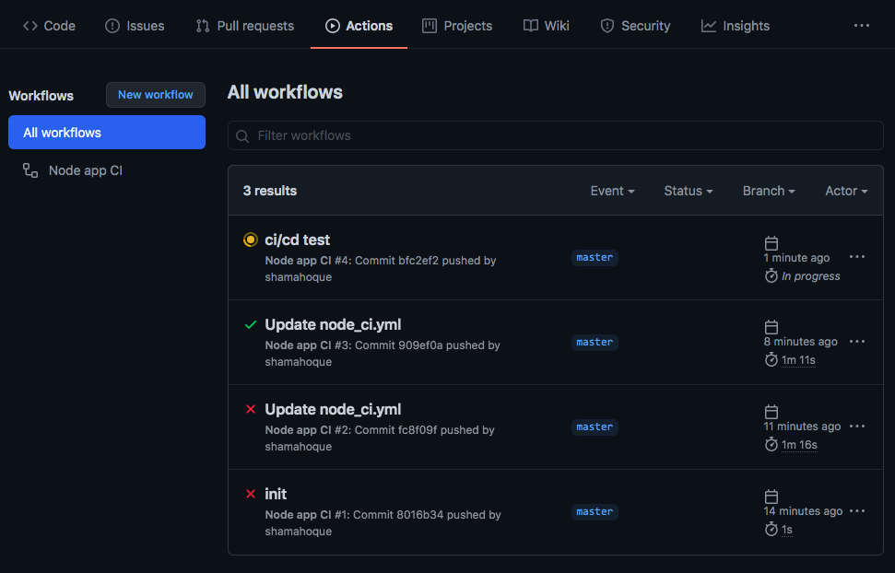
Push your code to GitHub
git add .
git commit -m 'ci/cd test'
git push origin master
Check your repository on
GitHub, go to the Actions tab
Every push runs the workflow
Red cross if any test fails
Green tick if all tests pass
You can identify which exact commit breaks the code / specifically fails which test

Slide 33
Continuous Deployment
Update GitHub Action
to auto deploy to Heroku

Slide 34
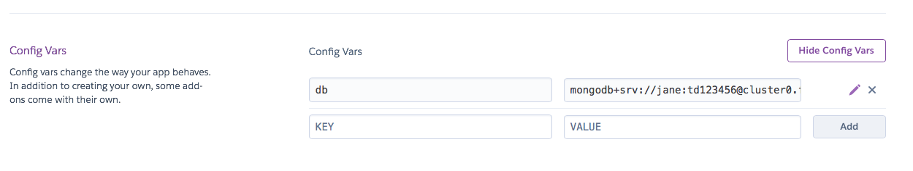
Create an app on Heroku and connect MongoDB Atlas DB
Create an app on Heroku
Create a cluster or use an existing cluster on MongoDB Atlas
Get the DB URL and add it to config in the Heroku app settings

Slide 35
Update GitHub action to auto deploy to Heroku
We can use Heroku deploy action from GitHub Marketplace: https://github.com/marketplace/actions/deploy-to-heroku
Update the node_ci.yml to use this action by adding the following after ‘npm test’ line:
- uses: akhileshns/heroku-deploy@v3.8.8
with:
heroku_api_key: ${{secrets.HEROKU_API_KEY}}
heroku_app_name: "YOUR APP’S NAME"
heroku_email: "YOUR EMAIL"
Now go to your Heroku account and go to Account Settings. Scroll to the bottom until you see API Key. Copy this key and go to your project's repository on GitHub.
In your Repo, go to Settings -> Secrets and click on "New Secret". Then enter HEROKU_API_KEY as the name and paste the copied API Key as the value.
You can now push your project to GitHub and it will be automatically deployed to Heroku henceforth.
You can learn more about GitHub Secrets here and GitHub Actions here

Slide 36
if you’ve made it this far, you have successfully set up a CI/CD pipeline for your app
Try yourself
Implement the remaining API endpoints
(PUT, DELETE) with test code and push to GitHub.
Each push will run the CI/CD pipeline.
Further reading: https://buddy.works/tutorials/author/shama-hoque

